Slide 1

Dynamics 365 Mobile – Take Another Look
Presented by Brian Begley - www.encloud9.com

Slide 2


About enCloud9
Dynamics 365 Cloud Customer Relationship Management – Silver 2014 - present
15 years experience working with small to mid sized businesses to modernize sales, marketing customer service
Work with companies throughout the US and Canada
Primary focus is on Cloud-based Dynamics 365 Customer Engagement Platform
About Dynamics365Support.com
Premier provider of low cost fixed fee support services for Dynamics 365, PowerApps and Flow

Slide 3
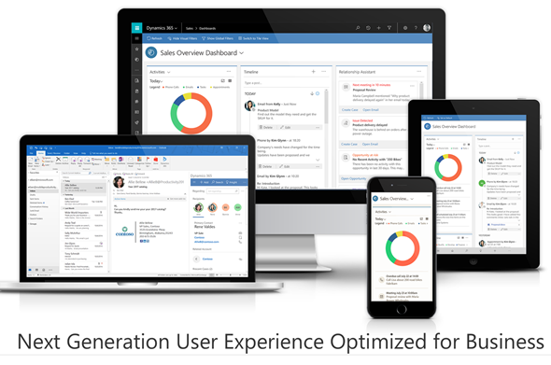
What is the Unified Interface?
Uses responsive web design principles to provide an optimal viewing and interaction experience for any screen size, device, or orientation.
Consistent and accessible user experience across devices—whether on a desktop, laptop, tablet, or phone.

Slide 4
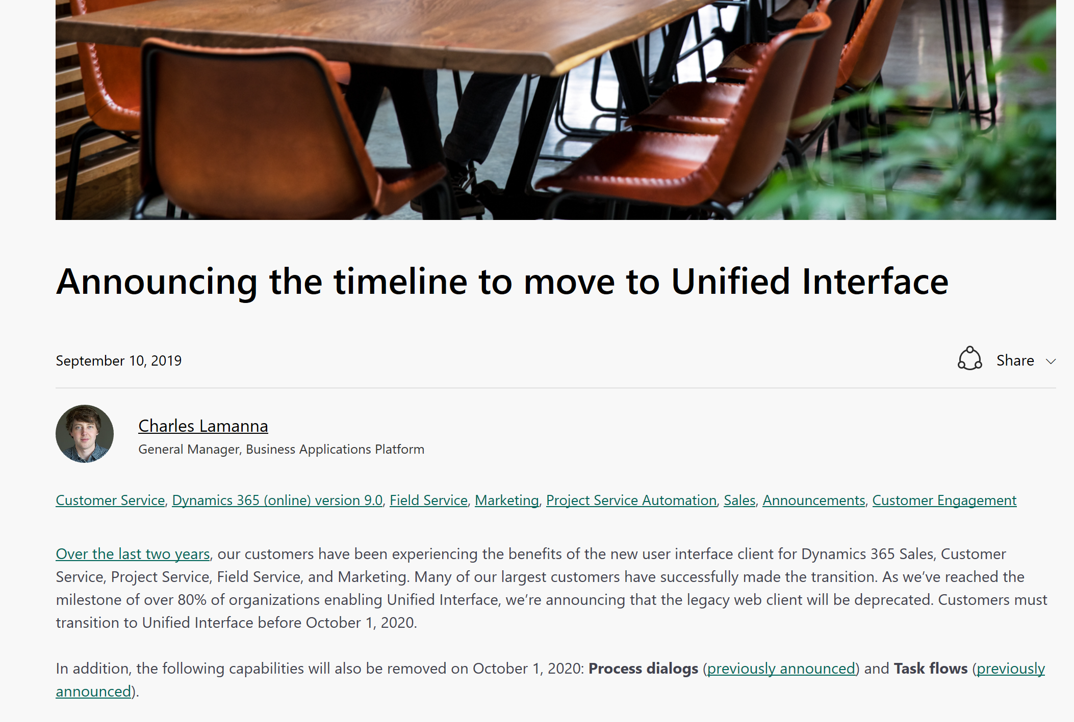
Do I have to switch to the Unified Interface?
As of October 1, 2020, the legacy web client will be deprecated (no longer available).
Customers must transition to UI prior to that date.
https://cloudblogs.microsoft.com/dynamics365/it/2019/09/10/announcing-the-timeline-to-move-to-unified-interface/

Slide 5
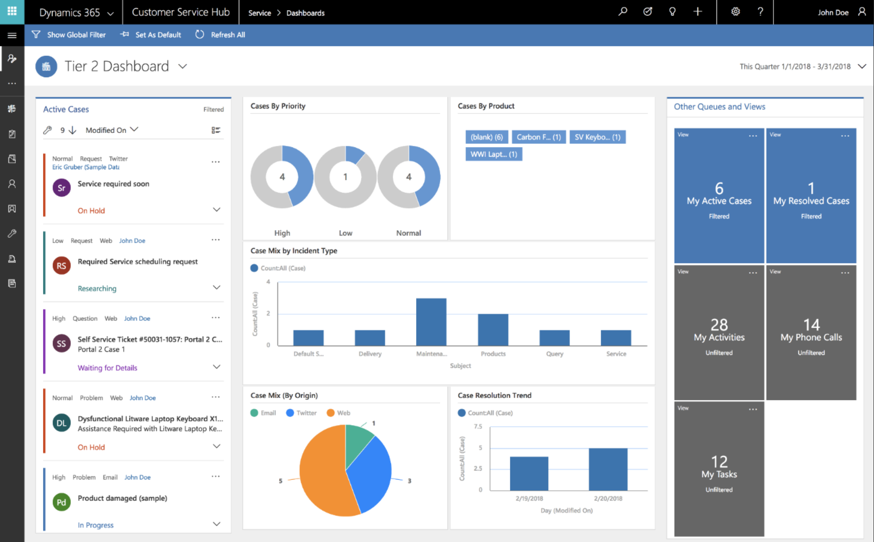
Best features of the Unified Interface.
Much faster than the classic User Interface
Hubs allow teams to have their own CRM application
Form Layout responds to the device you are using – ie mobile devices
Timeline improvements
  A single view of activities, notes, and posts
  Filtering and Sorting
  Conversational Nesting of emails
Interactive Dashboards
Reference Panel is now available with all entities.

Slide 6
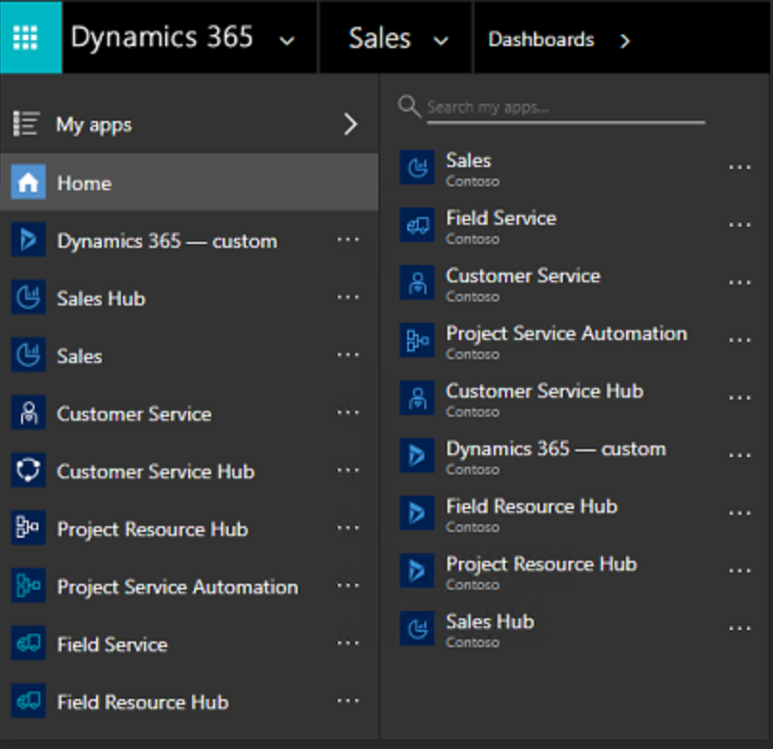
Best features of the Unified Interface.
Much faster than the classic User Interface
Hubs allow teams to have their own CRM application
Form Layout responds to the device you are using – ie mobile devices
Timeline improvements
  A single view of activities, notes, and posts
  Filtering and Sorting
  Conversational Nesting of emails
Interactive Dashboards
Reference Panel is now available with all entities.

Slide 7
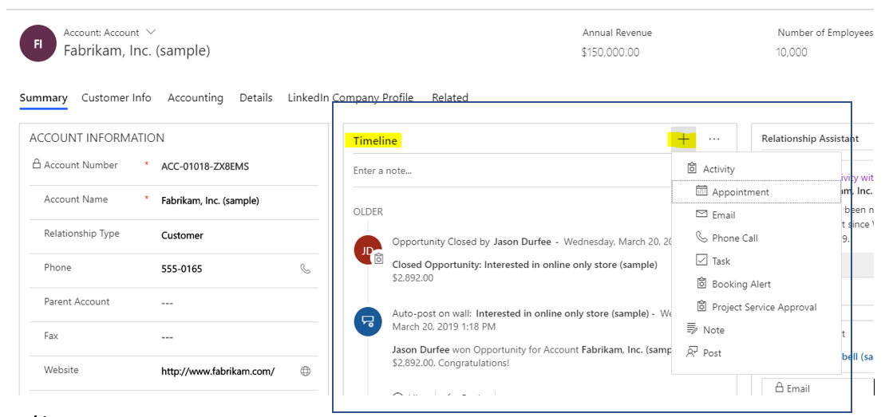
Best features of the Unified Interface.
Much faster than the classic User Interface
Hubs allow teams to have their own CRM application
Form Layout responds to the device you are using – ie mobile devices
Timeline improvements
  A single view of activities, notes, and posts
  Filtering and Sorting
  Conversational Nesting of emails
Interactive Dashboards
Reference Panel is now available with all entities.

Slide 8
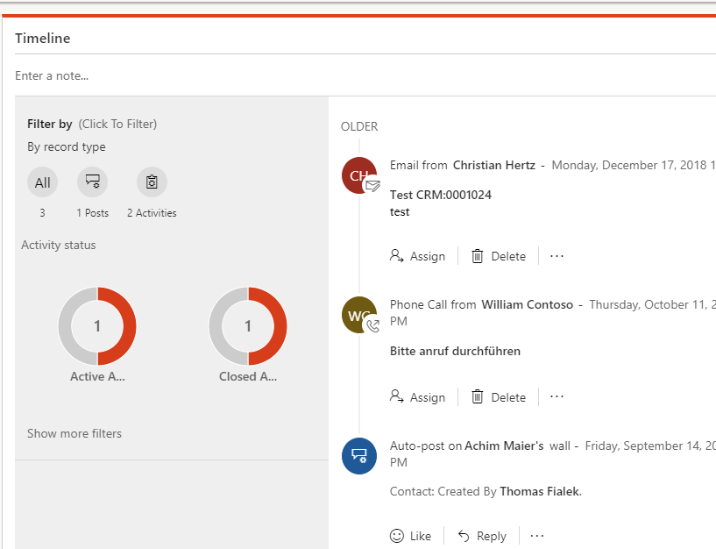
Best features of the Unified Interface.
Much faster than the classic User Interface
Hubs allow teams to have their own CRM application
Form Layout responds to the device you are using – ie mobile devices
Timeline improvements
  A single view of activities, notes, and posts
  Filtering and Sorting
  Conversational Nesting of emails
Interactive Dashboards
Reference Panel is now available with all entities.

Slide 9
Best features of the Unified Interface.
Much faster than the classic User Interface
Hubs allow teams to have their own CRM application
Form Layout responds to the device you are using – ie mobile devices
Timeline improvements
  A single view of activities, notes, and posts
  Filtering and Sorting
  Conversational Nesting of emails
Interactive Dashboards
Reference Panel is now available with all entities.

Slide 10
Let’s test drive the Unified Interface

Slide 11
enCloud9 ensures a smooth transition to the Unified Interface.
Sample migration plan
Gradual Migration plan
Move 1 team of users – ie Customer Service to their own Hub
  Refine hub based on their feedback
  Move other groups of users to their own hubs using feedback from original adopters.
  Repeat as needed
The experts at Dynamics365support.com have successfully moved dozens of clients to the Unified Interface and understand the steps to a smooth transition.
The best time to start planning is TODAY!
Change doesn’t have to be scary – allow our experts to manage the migration to the Unified Interface.
Let us take the uncertainty off of your shoulders and build out a migration plan for you.

Slide 12
enCloud9 ensures a smooth transition to the Unified Interface.
Sample migration plan
Gradual Migration plan
Move 1 team of users – ie Customer Service to their own Hub
  Refine hub based on their feedback
  Move other groups of users to their own hubs using feedback from original adopters.
  Repeat as needed
The experts at Dynamics365support.com have successfully moved dozens of clients to the Unified Interface and understand the steps to a smooth transition.
The best time to start planning is TODAY!
Contact us today at 1-844-264-0729 or sales@encloud9.com
Change doesn’t have to be scary – allow our experts to manage the migration to the Unified Interface.
Let us take the uncertainty off of your shoulders and build out a migration plan for you.

